Slide 1
Basics to R Analysis of a Randomized Controlled Trial

Slide 2
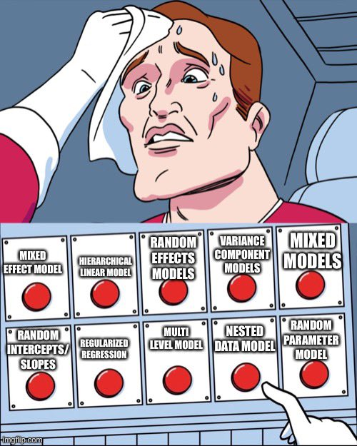
Outline for Today
What is a randomized controlled trial?
Basics to RCT Analyses
A crash course on mixed linear models
ANCOVA and MLM analysis in R

Slide 3










What is a Randomized Controlled Trial?
Baseline Assessment
Randomization
Experimental Group
Follow-up Assessment(s)
Control Group
X

Slide 4
RCT Analysis: Randomization Means Random
Randomized v1
Randomized v2
Randomized v3
Experimental Group
Experimental Group
Experimental Group
Randomization
Control Group
Control Group
Control Group
For which versions of randomization do we need to compare baseline differences?
Answer: We never need to compare baseline differences using hypothesis testing!

Slide 5
RCT Analysis: Covariates of a model
Always need to control for baseline outcome
Other covariates should be based on what could likely influence variation in treatment effects

Slide 6
RCT Analysis: Why do I need to control for baseline?
CON
INT
CON
INT
CON
INT
INT
INT
CON
CON
INT
CON
Baseline
Final
Baseline
Final
Baseline
Final
Controlling for baseline outcome values allows us to account for individual variation in performance at baseline, and confirm that improvement from an intervention is not due to chance or baseline performance.

Slide 7

RCT Analysis: Other covariates to include
Baseline Assessment
Randomization
Experimental Group
Baseline Differences Between Groups
Age
BMI
M/F ratio
Educational attainment
Cholesterol level
Fat mass
Reaction time
Episodic Memory
N= 100
N= 200
Control Group
N= 100

Slide 8
RCT Analysis: Other covariates to include
Question #1: Should we covary for each of these variables, given that they are significantly different between groups?
Answer #1: No! These differences are due to random chance.
Question #2: What variables might be good to covary for in our analysis?
Answer #2: Variables that likely impact the outcome of interest (i.e., muscular strength). Age, BMI, and sex seem reasonable. Fewer covariates is typically preferable.
Baseline Differences Between Groups
Age
BMI
M/F ratio
Educational attainment
Cholesterol level
Fat mass
Reaction time
Episodic Memory

Slide 9
RCT Analysis: ANCOVA
Baseline Assessment
Randomization
Experimental Group
Follow-up Assessment
Control Group

Slide 10
RCT Analysis: ANCOVA
Final Assessment Outcome = Group + Baseline Assessment Outcome + Covariates
Muscle Strength Final = Group + Muscle Strength Baseline + Covariates

Slide 11
RCT Analysis: Missing Data in ANCOVA
Baseline Assessment
Follow-up Assessment
Randomization
Experimental Group
Experimental Group
Control Group
Control Group
When there are missing data in an ANCOVA, you need to impute individuals with missing data in order to adhere to the Intention to Treat Principle.

Slide 12
RCT Analysis: Mixed linear modeling: A solution to issues of missing data in follow-up assesments
Baseline Assessment
Randomization
Experimental Group
Follow-up Assessment #1
Follow-up Assessment #2
Follow-up Assessment #3
Control Group

Slide 13
RCT Analysis: Mixed Linear Modeling
Baseline Assessment
Follow-up Assessment #1
Follow-up Assessment #2
Randomization
Experimental Group
Experimental Group
Experimental Group
Control Group
Control Group
Control Group
When there is more than one follow-up assessment, we can use mixed linear modeling (using maximum likelihood estimation) in order to include all participants in the model across time.

Slide 14
Mixed Linear Modeling: Understanding the model
Two-level Unconditional Model (i.e., Null/Intercept-Only Model)
Level 1 (Participants)
Y_{ij} = 𝛽_{0j} + r_{ij,} where r_{ij} ~N(0,𝜎²)
Level 2 (Time)
𝛽_{0j} = 𝛾₀₀ + 𝓊_{0j} where 𝓊_{0j} ~N(0,𝜏₀²), r_{ij} and 𝓊_{0j} are independent
Multilevel Model
Y_{ij} = 𝛾₀₀ + 𝓊_{0j} + r_{ij,}
i denotes level-1 units (Participants)
j denotes level-2 units (Time)

Slide 15

Mixed Linear Modeling: Understanding the model
$$\left(\begin{aligned}\text{Y}\text{1,1 } \\ \text{Y}\text{2,1} \\ \text{Y}\text{3,1 } \\ \text{. } \\ \text{.} \\ \text{.} \\ \text{Y}\text{40,1} \\ \text{Y}\text{1,2} \\ \text{Y}\text{2,2} \\ \text{.} \\ \text{.} \\ . \\ \text{ .} \\ \text{Y}\text{40,2} \\ \text{Y}\text{1,3} \\ \text{Y}\text{2,3} \\ \\ \text{.} \\ \text{.} \\ \text{ .} \\ \text{Y}\text{40,3} \end{aligned}\right)= \left(\begin{aligned}\text{1} \\ \text{1} \\ \text{1} \\ \text{. } \\ \text{.} \\ \text{.} \\ \text{1} \\ \text{1} \\ \text{1} \\ \text{.} \\ \text{.} \\ . \\ \text{ .} \\ \text{1} \\ \text{1} \\ \text{1} \\ \\ \text{.} \\ \text{.} \\ \text{ .} \\ \text{1} \end{aligned}\right) \left(γ\right)+ \left(\begin{aligned}\text{U}\text{1} \\ \text{U}\text{1} \\ \text{U}\text{1} \\ \text{. } \\ \text{.} \\ \text{.} \\ U\text{1} \\ \text{U}\text{2} \\ \text{U}\text{2} \\ \text{.} \\ \text{.} \\ . \\ \text{ .} \\ \text{U}\text{2} \\ \text{U}\text{3} \\ \text{U}\text{3} \\ \\ \text{.} \\ \text{.} \\ \text{ .} \\ \text{U}\text{3} \end{aligned}\right)+ \left(\begin{aligned}\text{R}\text{1,1 } \\ \text{R}\text{2,1} \\ \text{R}\text{3,1 } \\ \text{. } \\ \text{.} \\ \text{.} \\ \text{R}\text{40,1} \\ \text{R}\text{1,2} \\ \text{R}\text{2,2} \\ \text{.} \\ \text{.} \\ . \\ \text{ .} \\ \text{R}\text{40,2} \\ \text{R}\text{1,3} \\ \text{R}\text{2,3} \\ \\ \text{.} \\ \text{.} \\ \text{ .} \\ \text{R}\text{40,3} \end{aligned}\right)$$

Slide 16
Mixed Linear Modeling: Understanding the model
Random Intercept Model with Level-2 Predictors (Means as Outcome Model)
Level 1 (Participants)
Y_{ij} = 𝛽_{0j} + r_{ij,} where r_{ij} ~N(0,𝜎²)
Level 2 (Time)
𝛽_{0j} = 𝛾₀₀ + 𝛾₀₁W_{j} + 𝓊_{0j} where 𝓊_{0j} ~N(0,𝜏₀²), r_{ij} and 𝓊_{0j} are independent
𝛽_{1j} = 𝛾₁₀
Multilevel Model
Y_{ij} = 𝛾₀₀ + 𝛾₀₁W_{j} + 𝓊_{0j} + r_{ij,}
i denotes level-1 units (Participants)
j denotes level-2 units (Time)

Slide 17
Mixed Linear Modeling: Understanding the model
Random Intercept Model with Predictors at both levels
Level 1 (Participants)
Y_{ij} = 𝛽_{0j} + 𝛽_{1j}X_{ij} + r_{ij,} where r_{ij} ~N(0,𝜎²)
Level 2 (Time)
𝛽_{0j} = 𝛾₀₀ + 𝛾₀₁W_{j} + 𝓊_{0j} where 𝓊_{0j} ~N(0,𝜏₀²), r_{ij} and 𝓊_{0j} are independent
𝛽_{1j} = 𝛾₁₀
Multilevel Model
Y_{ij} = 𝛾₀₀ + 𝛾₀₁W_{j} + 𝛽_{1j}X_{ij} + 𝓊_{0j} + r_{ij,}
i denotes level-1 units (Participants)
j denotes level-2 units (Time)

Slide 18
Mixed Linear Modeling: Understanding the model
Outcome_{t} = Group * Time_{t} + Baseline Outcome + Baseline Covariates
Outcome_{t=2} = Group * Time_{t=2} + Baseline Outcome + Baseline Covariates
Outcome_{t=3} = Group * Time_{t=3} + Baseline Outcome + Baseline Covariates
EXAMPLE
Muscle Strength_{t} = Group * Time_{t} + Muscle Strength Baseline + Covariates
Muscle Strength_{t=2} = Group * Time_{t=2} + Muscle Strength Baseline + Baseline Covariates
Muscle Strength_{t=3} = Group * Time_{t=3} + Muscle Strength Baseline + Baseline Covariates

Slide 19
Mixed Linear Modeling: Random Effects vs. Fixed Effects
Mixed linear models use a combination (or mixture) of fixed effects and random effects
Fixed effects: An explanatory variable which has a fixed (or constant) relationship with the response variable across all observations
Muscle Strength_{t} = Group * Time_{t} + Muscle Strength Baseline + Age + Sex + BMI
Random effects: Variables that affect the outcome vary randomly across individuals and groups
Muscle Strength_{t} = Group*Time_{t} + (1|ID)

Slide 20
Mixed Linear Modeling: Understanding Random Effects
There are two types of random effects we commonly use: random intercepts and random slopes
Random Intercepts: The intercepts of a model are allowed to vary, and thus the scores on the DV for each individual observation are predicted by the intercept that varies across groups (slopes are considered fixed).
Outcome_{t} = Group * Time_{t} + Baseline Outcome + Baseline Covariates + (1|ID)
Random slopes: The slopes of a model are allowed to vary across time. When using random slopes, we typically also include random intercepts too.
Outcome_{t} = Group * Time_{t} + Baseline Outcome + Baseline Covariates + (Time_{t}|ID)

Slide 21
Mixed Linear Modeling: Understanding Random Effects
Random Intercepts Model
Random Slopes Model
Random Intercepts & Slopes Model
1
2
3
1
2
3
1
2
3

Slide 22
Mixed Linear Modeling: Is time a fixed or random effect?
Time can be treated as a fixed or random effect depending on the situation. However, we typically treat time as a fixed and categorical variable in most RCT analyses.
CON
INT
CON
INT
CON
INT
Timepoint 1
Timepoint 2
Timepoint 3
1
2
3

Slide 23
Mixed Linear Modeling: Putting it all together
There are three effects which are typically of interest in the mixed linear model:
1. The Group Effect: This effect indicates the mean outcome score for each group independent of time
Outcome_{t} = Group * Time_{t} + Baseline Outcome + Baseline Covariates + Random Effects
2. The Time Effect: This effect indicates the mean outcome score at each timepoint independent of group
Outcome_{t} = Group * Time_{t} + Baseline Outcome + Baseline Covariates + Random Effects
3. The Group x Time Effect: This effect indicates the mean outcome score for each group at each time point
Outcome_{t} = Group * Time_{t} + Baseline Outcome + Baseline Covariates + Random Effects

Slide 24
Mixed Linear Modeling: Putting it all together
Once we have estimated the Group x Time effects, we can then estimate between-group differences at each timepoint (i.e., did the INT have better performance at each follow-up timepoint than the CON?).
Model
Outcome_{t} = Group * Time_{t} + Baseline Outcome_{t}
Hypothesis Test #1
H₀: INT_{t=1} – CON_{t=1} = 0
H_{A}: INT_{t=1} – CON_{t=1} ≠ 0
Hypothesis Test #2
H₀: INT_{t=2} – CON_{t=2} = 0
H_{A}: INT_{t=2} – CON_{t=2} ≠ 0
Hypothesis Test #3
H₀: INT_{t=3} – CON_{t=3} = 0
H_{A}: INT_{t=3} – CON_{t=3} ≠ 0
CON
INT
CON
INT
CON
INT
Follow-up 1
Follow-up 2
Follow-up 3

Slide 25
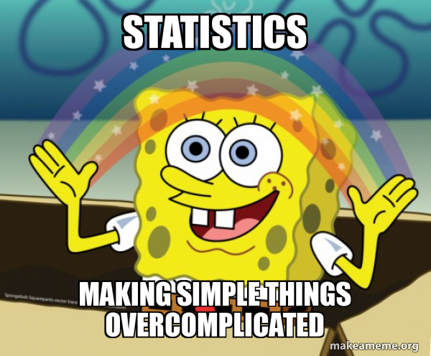
Summary
DO NOT TEST FOR BASELINE DIFFERENCES IN A RCT!!!
The most common analyses types for an RCT are ANCOVA and Mixed Linear Modeling
ANCOVA is easier to analyze, but harder to adhere to intention-to-treat principle
Mixed Linear Modeling is harder to analyze, but makes it easier to adhere to intention to treat and also provides greater statistical power (i.e., repeated measures)

